Slide 1
Data Fusion for Tomato Seedlings Classification
Group 5 - Pitch
Theodoros Antoniou
Fivos Tzavellos
Spyridon Giagtzoglou
Ioannis Grepsios
Stavros Nikoletopoulos

Slide 2
Approaches
High Level
Image Fusion
Mid Level
Image Fusion
Mid-High Level
Expert Fusion

Slide 3
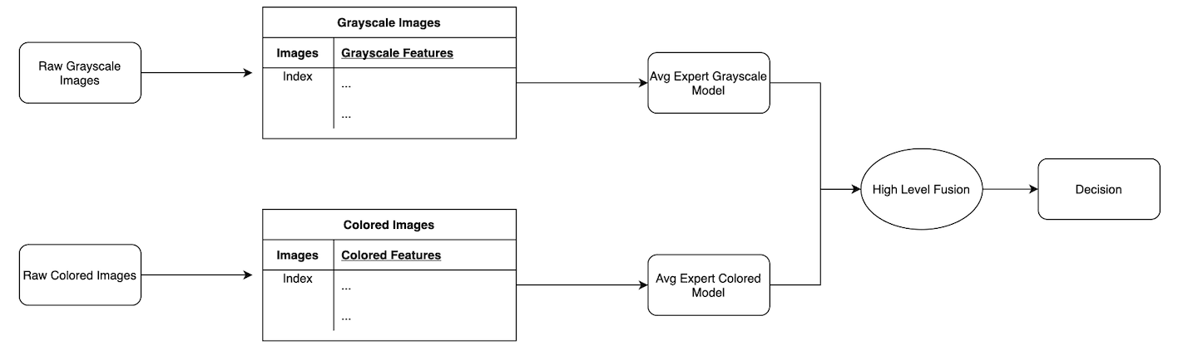
High Level Image Fusion

Slide 4
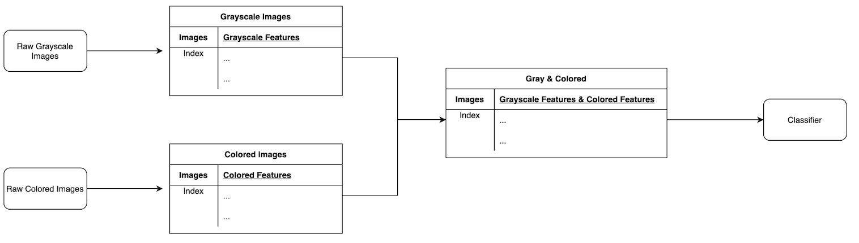
Mid Level Image Fusion

Slide 5
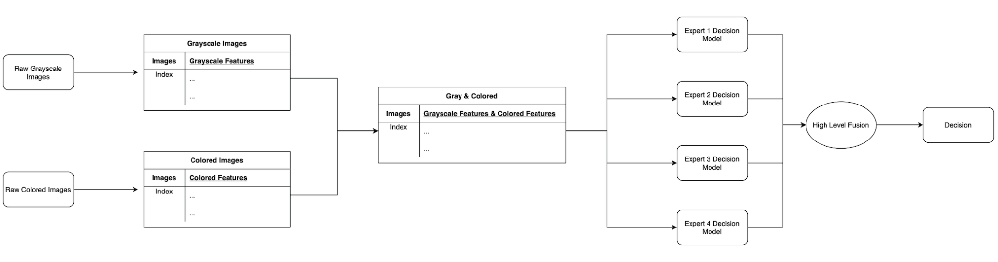
Mid-High level Expert Fusion

Slide 6
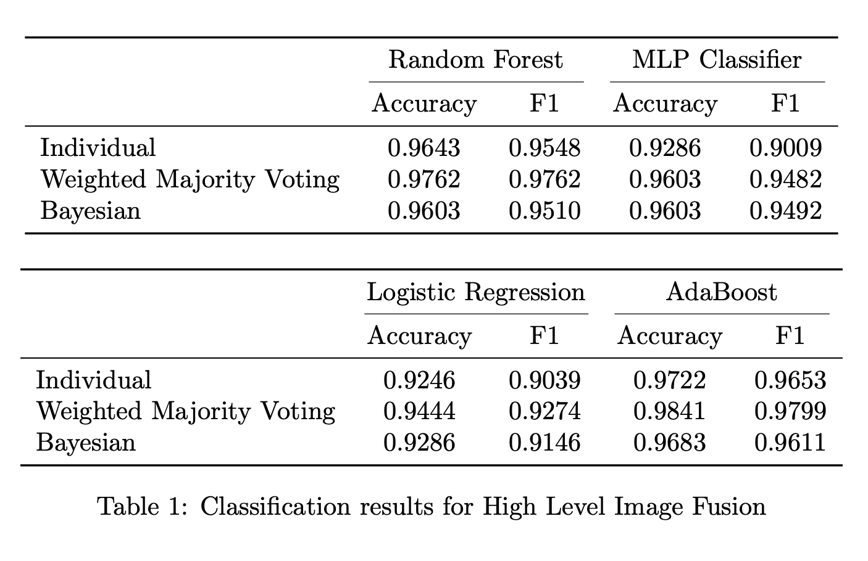
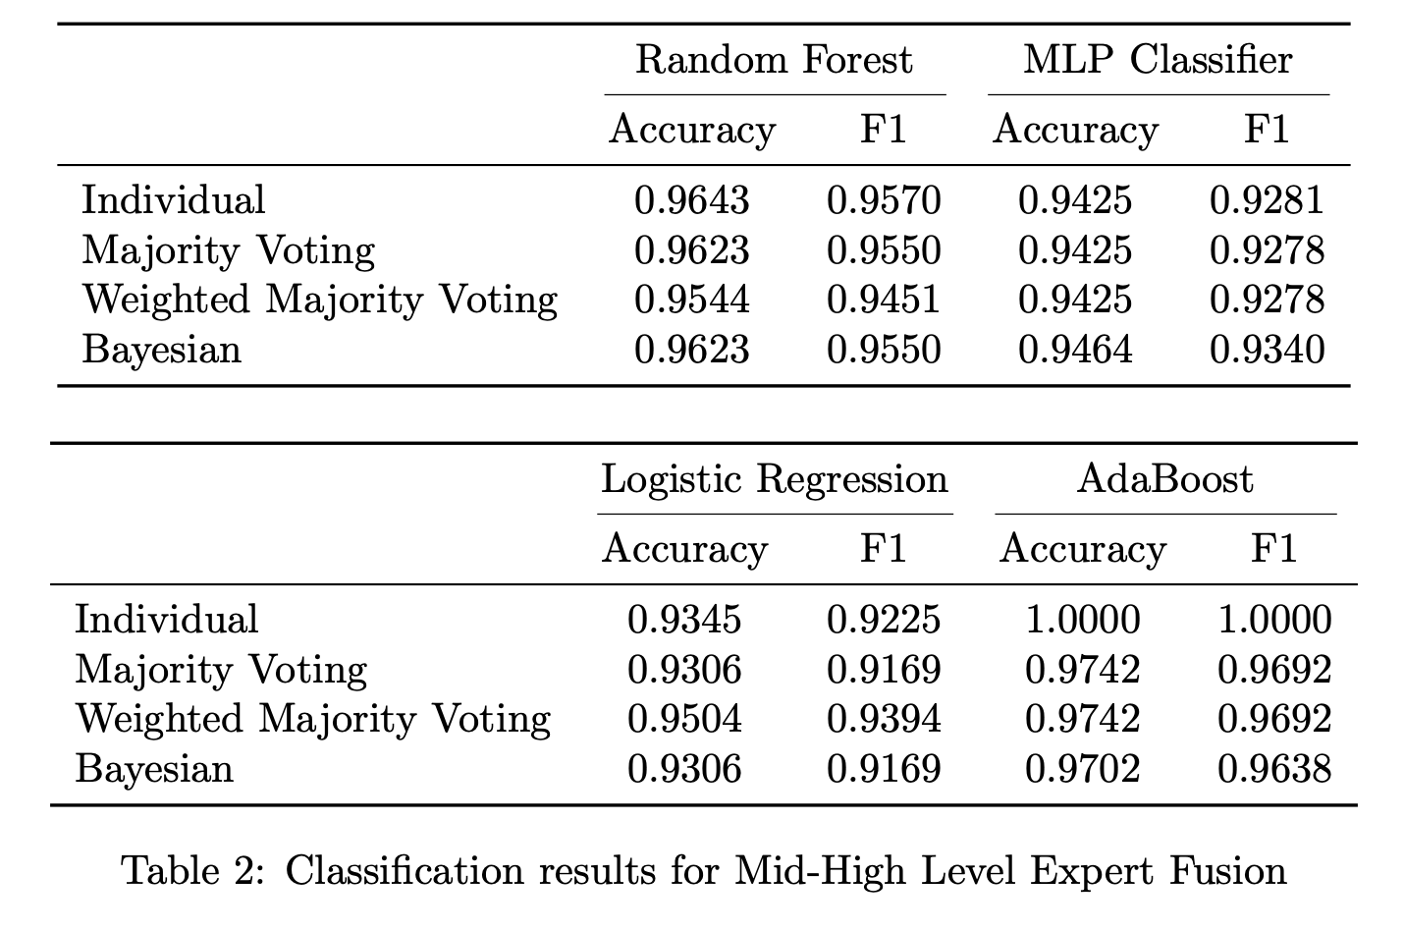
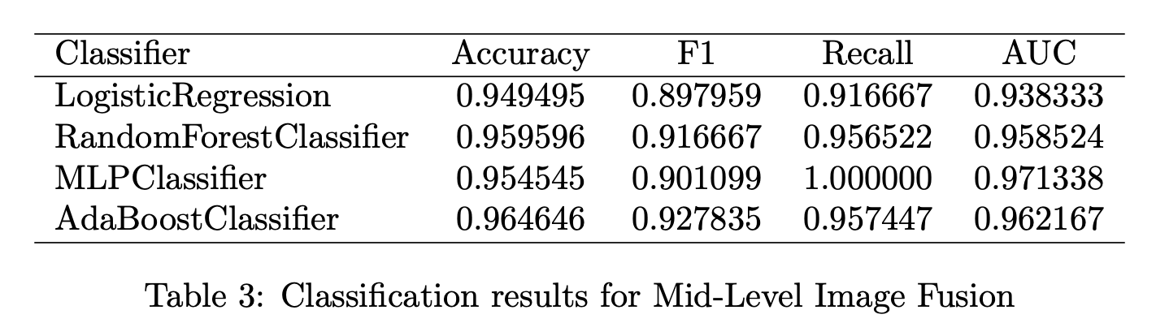
Most Significant Results

Slide 7
Most Proud of
The combination of Mid-level image fusion with High-Level Expert fusion that yielded the best results
AdaBoost ( F1: 1.0 )
7.7% increase in F1-score for AdaBoost Classifier when switching from Mid to Mid-High Level Fusion
Team Spirit

